Slide 1
Workshop : Virtualization vs Containerization
Workshop virtualisasi dan kontainerisasi dalam rangka knowledge sharing Prodi Teknik Informatika fakultas ilmu komputer universitas dian nuswantoro semarang – 29 Agustus 2019
By : L. Budi handoko

Slide 2
Virtualization
Virtualization is creation of an alternative to actual version of something:
virtual memory (more memory than physically available),
virtual time (buffering provides virtual/effective download time that less than the actual time),
virtual hardware, desktop, disk, appliances, scenes, address, name, services, worlds, etc.
In our context it is realizing one or more complete computer systems as guests on the base machine/operating system.
This offers an excellent conduit for delivering the vastly underutilized power of the multi-core and other resources such as storage and devices.

Slide 3
Virtualization (cont.)
Fundamental idea – abstract hardware of a single computer (or software) into several different execution environments
Similar to layered approach
But layer creates virtual system (virtual machine, or VM) on which operation systems or applications can run
Several components
Host – underlying hardware system
Virtual machine manager (VMM) or hypervisor – creates and runs virtual machines by providing interface that is identical to the host
(Except in the case of paravirtualization)
Guest – process provided with virtual copy of the host
Usually an operating system
Single physical machine can run multiple operating systems concurrently, each in its own virtual machine

Slide 4
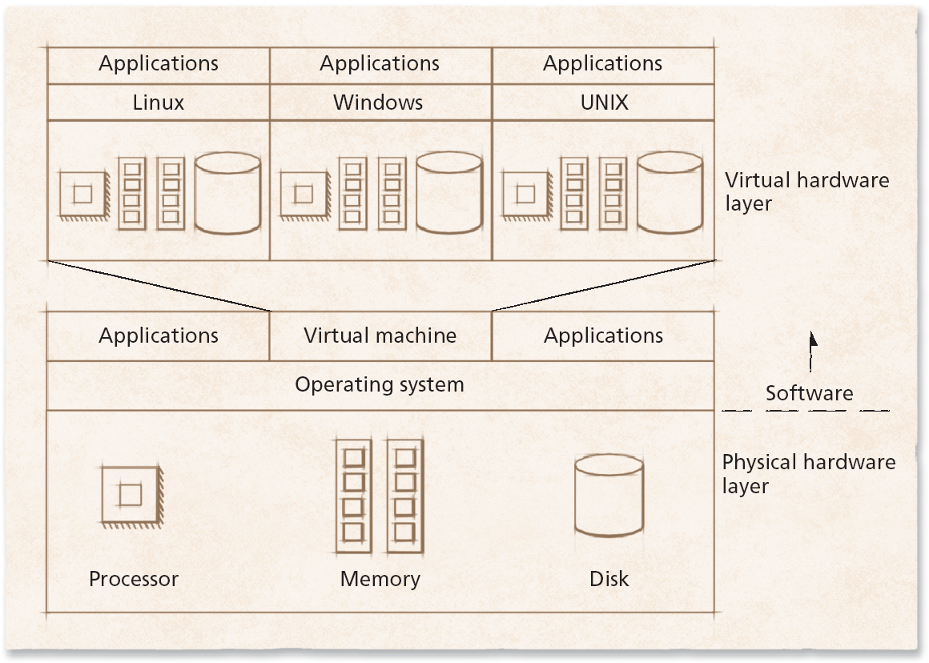
Schematic of a virtual machine

Slide 5
Virtualization (cont.)
Allows operating systems to run applications within other OSes
Vast and growing industry
Emulation (≠ Simulation) used when source CPU type different from target type (i.e. PowerPC to Intel x86)
Generally slowest method
When computer language not compiled to native code – Interpretation
Virtualization – OS natively compiled for CPU, running guest OSes also natively compiled
Consider VMware running WinXP guests, each running applications, all on native WinXP host OS
VMM (virtual machine Manager) provides virtualization services

Slide 6
Computing Environments - Virtualization

Slide 7
Implementation of VMMs
Other variations than “Full Virtualization” include:
Paravirtualization - Technique in which the guest operating system is modified to work in cooperation with the VMM to optimize performance
Programming-environment virtualization - VMMs do not virtualize real hardware but instead create an optimized virtual system
Used by Oracle Java and Microsoft.Net
Emulators – Allow applications written for one hardware environment to run on a very different hardware environment, such as a different type of CPU
Application containment - Not virtualization at all but rather provides virtualization-like features by segregating applications from the operating system, making them more secure, manageable
Including Oracle Solaris Zones, BSD Jails, and IBM AIX WPARs
Much variation due to breadth, depth and importance of virtualization in modern computing

Slide 8
Types of VMs – Emulation
Another (older) way for running one operating system on a different operating system
Virtualization requires underlying CPU to be same as guest was compiled for
Emulation allows guest to run on different CPU
Necessary to translate all guest instructions from guest CPU to native CPU
Emulation, not virtualization
Useful when host system has one architecture, guest compiled for other architecture
Company replacing outdated servers with new servers containing different CPU architecture, but still want to run old applications
Performance challenge – order of magnitude slower than native code
New machines faster than older machines so can reduce slowdown
Very popular – especially in gaming where old consoles emulated on new

Slide 9
Types of VMs – Programming Environment Virtualization
Also not-really-virtualization but using same techniques, providing similar features
Programming language is designed to run within custom-built virtualized environment
For example Oracle Java has many features that depend on running in Java Virtual Machine (JVM)
In this case virtualization is defined as providing APIs that define a set of features made available to a language and programs written in that language to provide an improved execution environment
JVM compiled to run on many systems (including some smart phones even)
Programs written in Java run in the JVM no matter the underlying system
Similar to interpreted languages

Slide 10
Types of VMs – Application Containment
Some goals of virtualization are segregation of apps, performance and resource management, easy start, stop, move, and management of them
Can do those things without full-fledged virtualization
If applications compiled for the host operating system, don’t need full virtualization to meet these goals
Oracle containers / zones for example create virtual layer between OS and apps
Only one kernel running – host OS
OS and devices are virtualized, providing resources within zone with impression that they are only processes on system
Each zone has its own applications; networking stack, addresses, and ports; user accounts, etc
CPU and memory resources divided between zones
Zone can have its own scheduler to use those resources

Slide 11
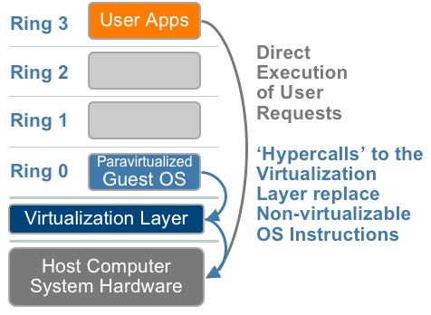
Types of VMs – Paravirtualization (OS-Assisted)
Modify the OS kernel to replace non-virtualizable instructions with hypercalls that comm directly with the virtualization layer hypervisor
Hypervisor also provides hypercall interfaces for other critical kernel ops such as mem management, interrupt handling and time keeping

Slide 12
Types of VMs – Paravirtualization (cont.)
Does not fit the definition of virtualization – VMM not presenting an exact duplication of underlying hardware
But still useful!
VMM provides services that guest must be modified to use
Leads to increased performance
Less needed as hardware support for VMs grows
Xen, leader in paravirtualized space, adds several techniques
For example, clean and simple device abstractions
Efficient I/O
Good communication between guest and VMM about device I/O
Each device has circular buffer shared by guest and VMM via shared memory

Slide 13
Types of VMs – Paravirtualization (cont.)
Xen, leader in paravirtualized space, adds several techniques (Cont.)
Memory management does not include nested page tables
Each guest has own read-only tables
Guest uses hypercall (call to hypervisor) when page-table changes needed
Paravirtualization allowed virtualization of older x86 CPUs (and others) without binary translation
Guest had to be modified to use run on paravirtualized VMM
But on modern CPUs Xen no longer requires guest modification -> no longer paravirtualization

Slide 14
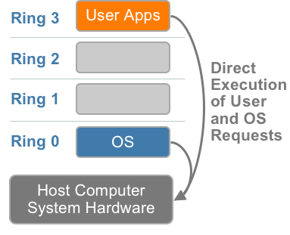
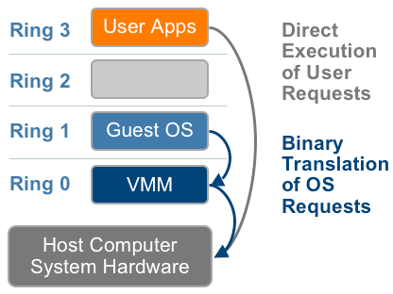
Full Virtualization (Bare Metal)
User level codes are executed directly on the processor
Translate kernel code to replace non-virtualizable instructions with new sequences of instructions that have the intended effects on the virtual hardware.
X86 privileged level arch w/o virtualization
Binary translation

Slide 15
Benefits and Features
Host system protected from VMs, VMs protected from each other
I.e. A virus less likely to spread
Sharing is provided though via shared file system volume, network communication
Freeze, suspend, running VM
Then can move or copy somewhere else and resume
Snapshot of a given state, able to restore back to that state
Some VMMs allow multiple snapshots per VM
Clone by creating copy and running both original and copy
Great for OS research, better system development efficiency
Run multiple, different OSes on a single machine
Consolidation, app dev, …

Slide 16
Benefits and Features (cont.)
Templating – create an OS + application VM, provide it to customers, use it to create multiple instances of that combination
Live migration – move a running VM from one host to another!
No interruption of user access
All those features taken together -> cloud computing
Using APIs, programs tell cloud infrastructure (servers, networking, storage) to create new guests, VMs, virtual desktops

Slide 17
HostOS/GuestOS Products
VMware Workstation: introductory package for small environments: limited use in large environments
Sun(now Oracle) xVM or Virtual Box: favorite among academicians. Adjustable video memory, remote device connectivity, RDP connectivity, snappy performance, may be best hosted virtualization package.
Others:
Free: OpenVZ, Xen, KVM, Qemu, etc.
Commercial: Virtuozzo, Ms. Virtual Server (VPC), Xen Enterprise, Virtual Iron, etc.

Slide 18
Hypervisor Products
Hypervisor: Hypervisor is a bare metal approach; is installed on the bare metal and then the operating systems is installed (paravirtualized); the operating system is designed as VM zero.
Ex: VMware ESXi: 32MB footprint!
Hardware is virtualization optimized
VM management via Direct Console User Interface (DCUI) at the physical console of the server system
Vmkernel allows for remote mangement vis a set of APIs and agents.
Other example for free to try : Proxmox

Slide 19
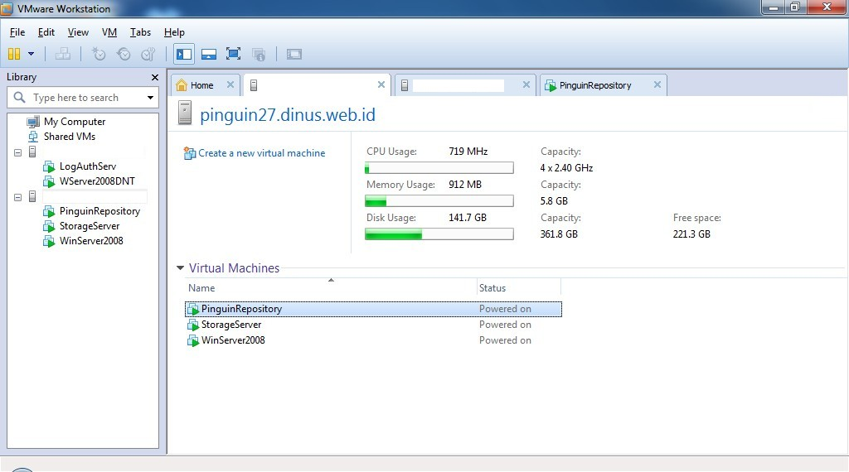
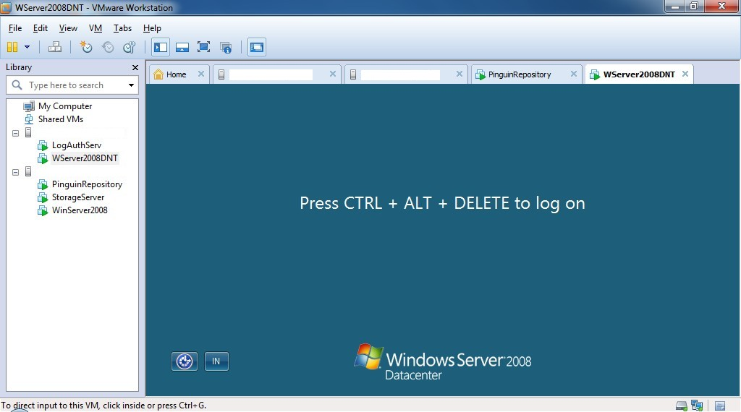
Example

Slide 20
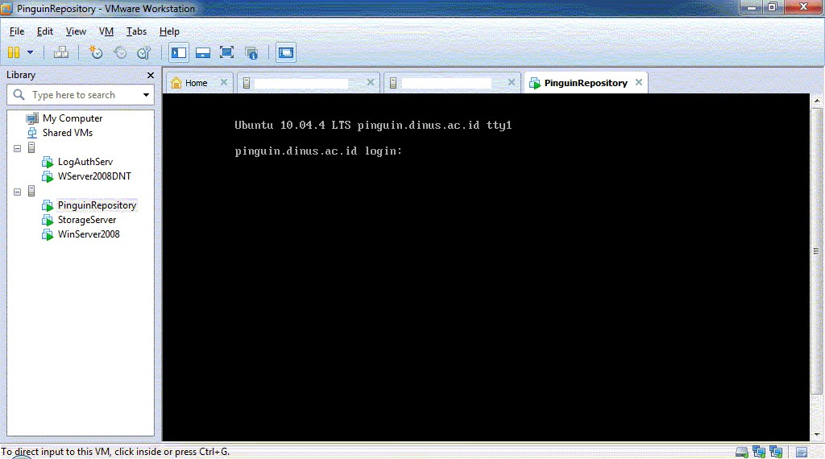

Slide 21
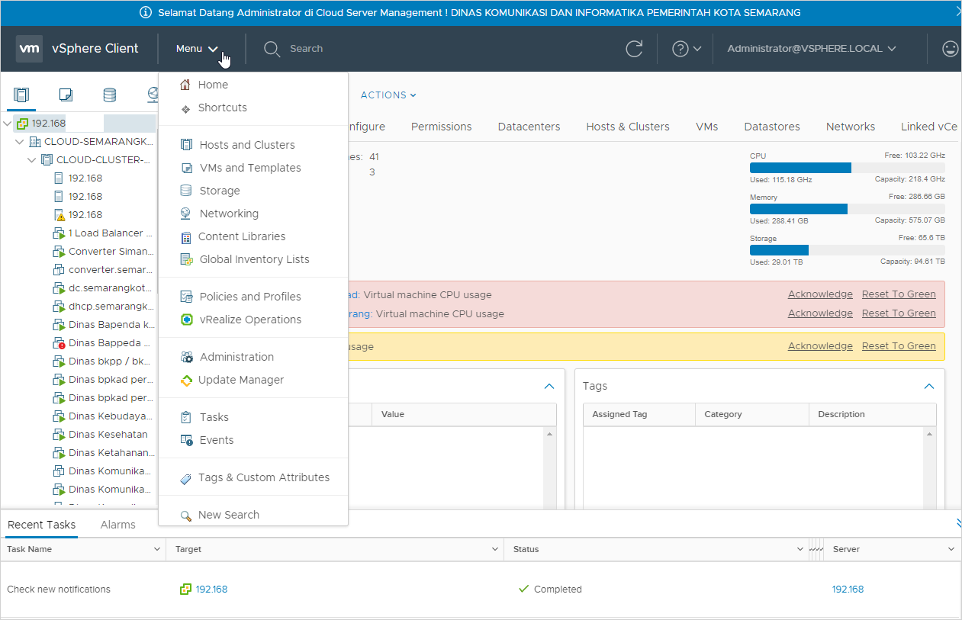

Slide 22
Containerization
Operating system (OS) virtualization has grown in popularity over the last decade to enable software to run predictably and well when moved from one server environment to another. But containers provide a way to run these isolated systems on a single server or host OS.
Containers sit on top of a physical server and its host OS—for example, Linux or Windows. Each container shares the host OS kernel and, usually, the binaries and libraries, too. Shared components are read-only. Containers are thus exceptionally “light”—they are only megabytes in size and take just seconds to start, versus gigabytes and minutes for a VM.
Containers also reduce management overhead. Because they share a common operating system, only a single operating system needs care and feeding for bug fixes, patches, and so on. This concept is similar to what we experience with hypervisor hosts: fewer management points but slightly higher fault domain. In short, containers are lighter weight and more portable than VMs.

Slide 23
Advantages
The average container size is within the range of tens of MB while VMs can take up several gigabytes. Therefore a server can host significantly more containers than virtual machines.
Running containers is less resource intensive then running VMs so you can add more computing workload onto the same server.
Provisioning containers only take a few seconds or less, therefore, the data center can react quickly to a spike in user activity.
Containers can enable you to easily allocate resources to processes and to run your application in various environments.
Using containers can decrease the time needed for development, testing, and deployment of applications and services.
Testing and bug tracking also become less complicated since you there is no difference between running your application locally, on a test server, or in production.
Containers are a very cost effective solution. They can potentially help you to decrease your operating cost (less servers, less staff) and your development cost (develop for one consistent runtime environment).
Container-based virtualization are a great option for micro-services, DevOps, and continuous deployment.

Slide 24
Disadvantages
One of the main disadvantages of container-based virtualization compared to traditional virtual machines is security. Containers share the kernel, other components of the host operating system, and they have root access. This means that containers are less isolated from each other than virtual machines, and if there is a vulnerability in the kernel it can jeopardize the security of the other containers as well.
Virtual Machines only share the hypervisor which has less functionality and less prone to attacks than the shared kernels of the containers. The system hardware is presented to the VMs in a virtualized form so intrusions, viruses, and other malicious activities cannot spread over to other VM.
Less flexibility in operating systems. You need to start a new server to be able to run containers with different operating systems. While virtual machines with any kind of OS can live next to each other on the same server. This might not be a problem for hosting providers, but for complex enterprise application this can be a serious constrain.
Another challenge is networking. Deploying containers in a sufficiently isolated way while maintaining an adequate network connection can be tricky. There are solutions that are addressing this issue such as Weave Net 1.5 but as it looks like at the moment there is still room to improve.

Slide 25
Container Products
LXC (Linux Containers)
Mesos
OpenVZ
The FreeBSD jail
The AIX Workload partition (WPARs)
Solaris Containers (Solaris Zones)
Hyper-V Container
Docker
etc.

Slide 26
Virtualization vs Containerization
Virtual Machine
Container

Slide 27
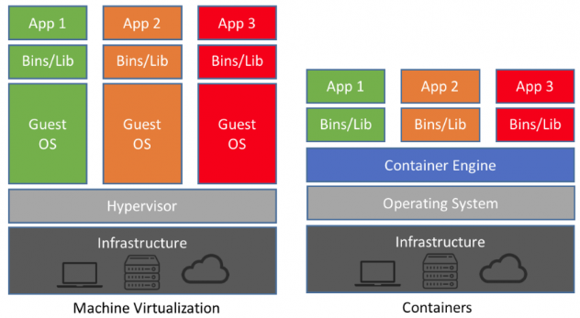
Virtualization vs Containerization

Slide 28
Virtualization vs Containerization
Virtual machines contain a complete operating system and applications.
Hypervisor-based virtualization is resource intensive, a VM can take up several GB depends on the guest the OS.
Virtual machines use hypervisors to share and manage hardware while containers share the kernel of the host OS to access the hardware.
Virtual machine have their own kernel and they don’t use and share the kernel of the host OS, hence they isolated from each other at a deep level.
Virtual machines residing on the same server can run different operating systems. One VM can run Windows while the VM next door might be running Ubuntu.
Containers are bound by the host operating system, containers on the same server use the same OS.
Containers are virtualizing the underlying operating system while virtual machines are virtualizing the underlying hardware.

Slide 29
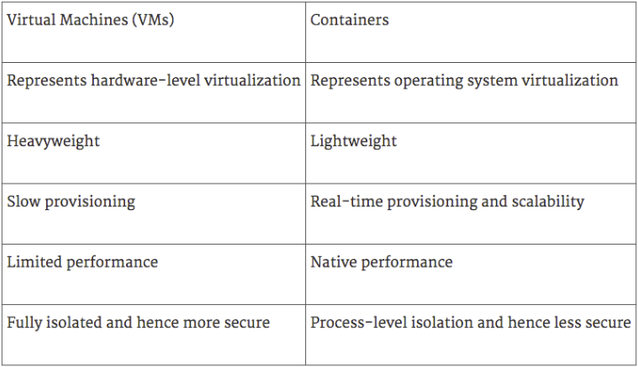
Virtualization vs Containerization

Slide 30
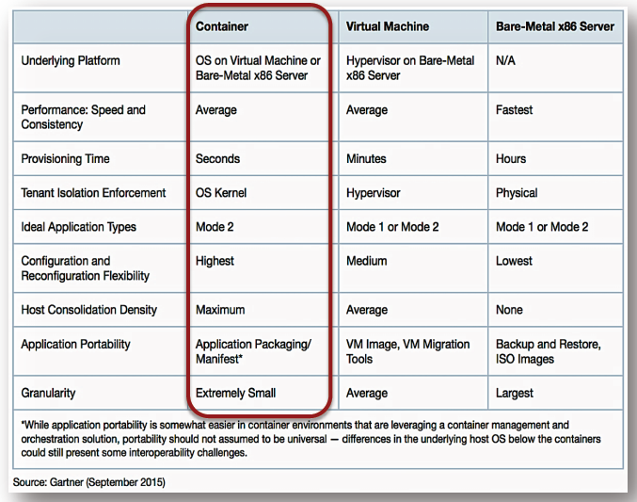

Slide 31
Development, Provisioning and Automation Tools for Virtualization and Containerization
Kubernetes (Container Management)
Vagrant → Development Environments (Terraform → Infrastructure)
Latest (New Release, 26-08-2019) : Tanzu (by VMware - https://techcrunch.com/2019/08/26/vmware-is-bringing-vms-and-containers-together-taking-advantage-of-heptio-acquisition/) → Both, virtualization and containerization management on single apps / system.

Slide 32
Combined as Final Product
HCI
(Hyper-Convergent Infrastructure)

Slide 33
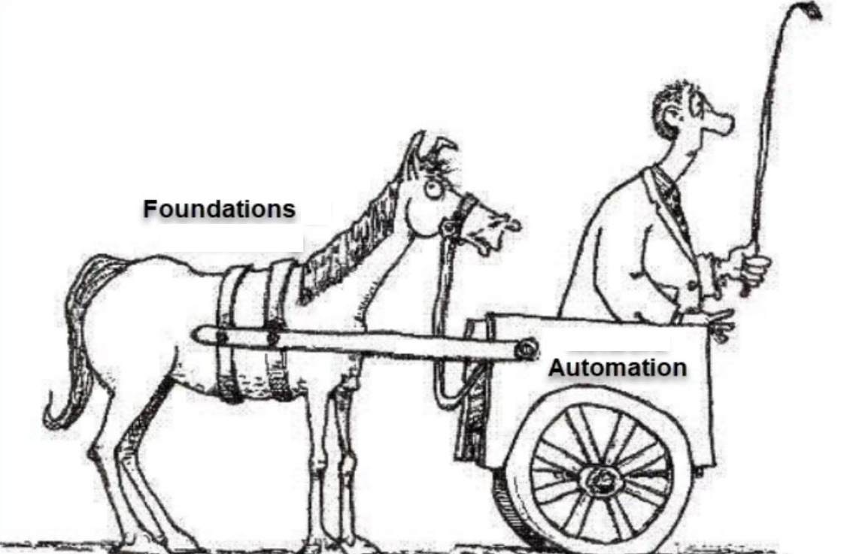
Terima Kasih

